Slide 1

Amazon Web Services
Lecture-1
www.corvit.com

Slide 2
Topics
What is Cloud Computing
Cloud Computing Service Models
Amazon Web Services
IAM
EC2 Instances
Types of EC2 Instances.
EC2 Instance Purchasing Model
www.corvit.com

Slide 3
What is Cloud Computing
Cloud computing is a model for enabling convenient, on-demand network access to a shared pool of configurable computing resources (e.g., networks, servers, storage, applications, and services) that can be rapidly provisioned and released with minimal management effort or service provider interaction. National Institute of Standards and Technology NIST SP 800-145
www.corvit.com

Slide 4
Cloud Computing Characteristics
On-demand
Infrastructure available as needed via a self-service interface
Network access
Infrastructure accessed via a broad network (generally Internet)
Resource pooling
Infrastructure aggregated into large resource pools which are subsequently partitioned to support specific functions
Elasticity
Ability to rapidly provision and de-provision services as needed
Utility service
Pay-for-usage pricing model with no minimum commitments
www.corvit.com

Slide 5
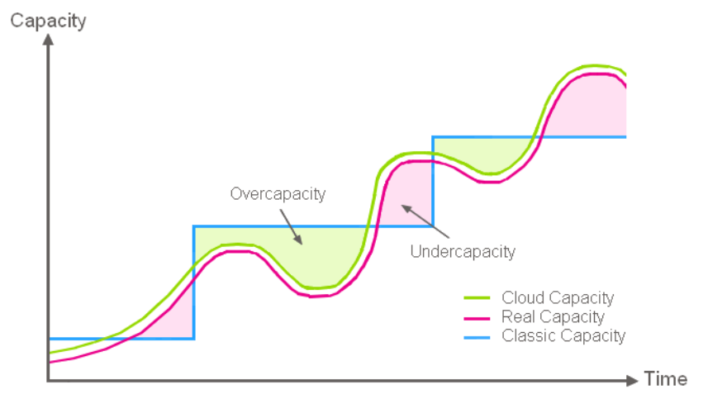
Cloud Computing Benefits
Align infrastructure capacity with current IT demand to achieve cost savings.
www.corvit.com

Slide 6
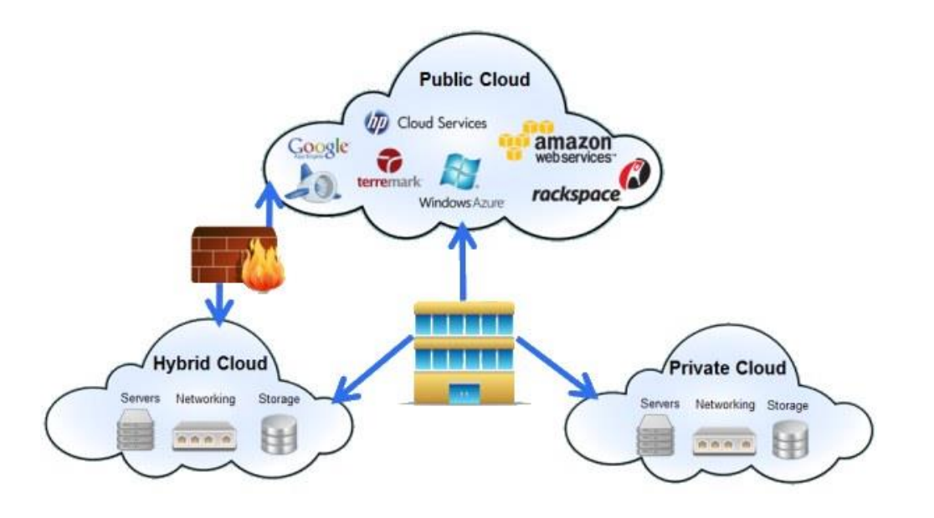
Cloud Deployment Models
www.corvit.com

Slide 7
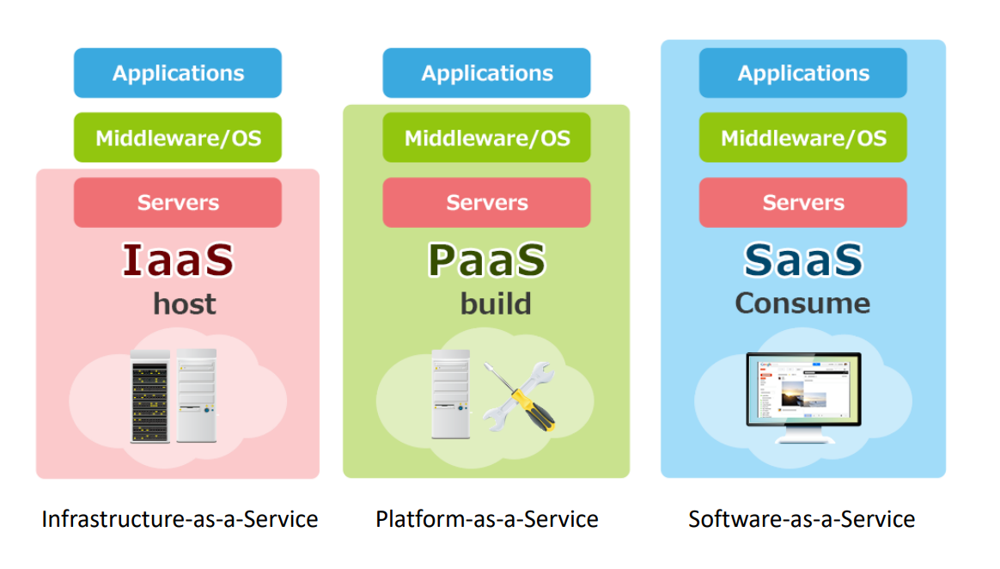
Cloud Computing Service Models
www.corvit.com

Slide 8
Amazon Web Services
1st public cloud computing platform – Chris Pinkman and Benjamin Black described what Amazon infrastructure should like and how it could be sold as a service. – Simple Queue Service (SQS) launched in 2004. – S3 & EC2 (AWS) launched in 2006.
Largest public cloud provider – AWS is larger than the next 3 largest cloud providers combined.
Amazon.com runs on top of AWS (though on completely separate infrastructure).
www.corvit.com

Slide 9
AWS Free Account Creation
www.corvit.com

Slide 10
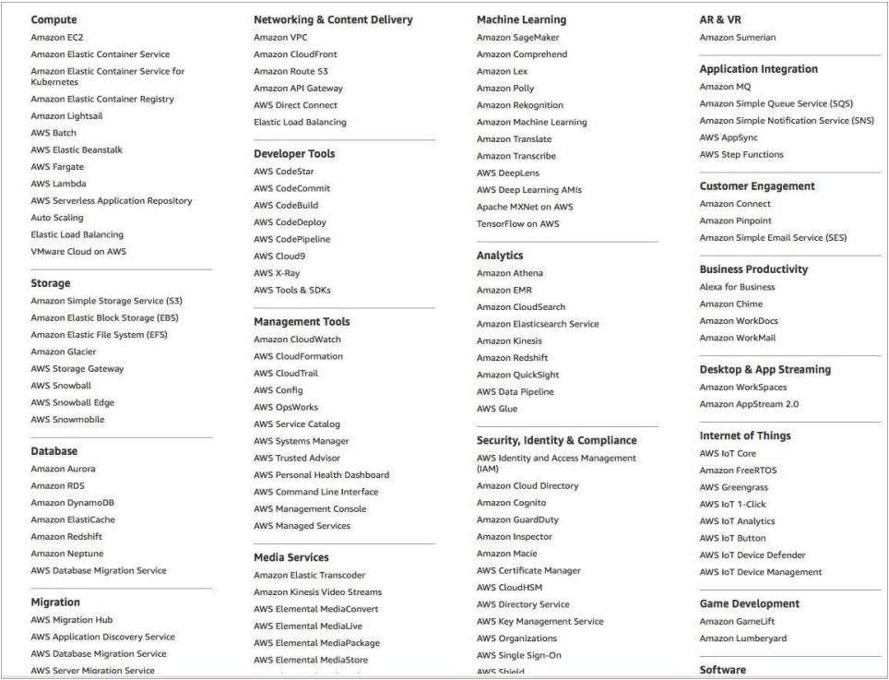
AWS Ecosystem
www.corvit.com

Slide 11
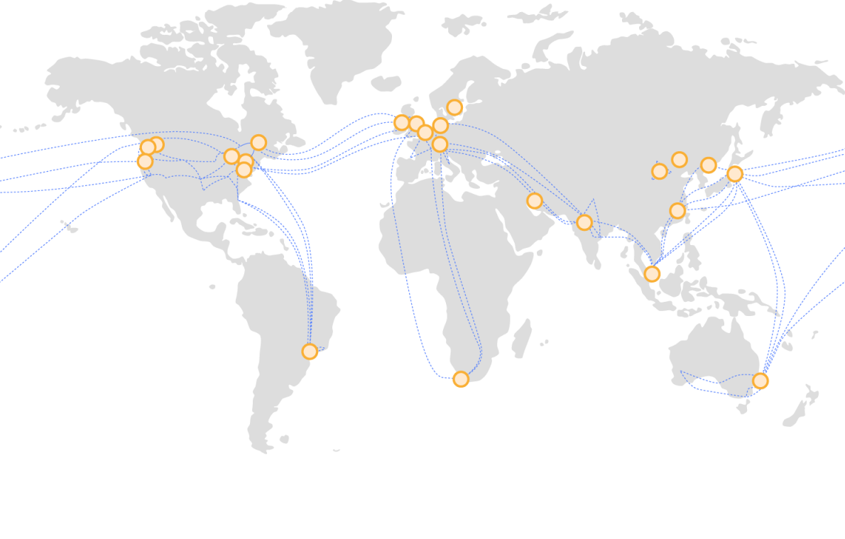
Global Infrastructure
www.corvit.com

Slide 12
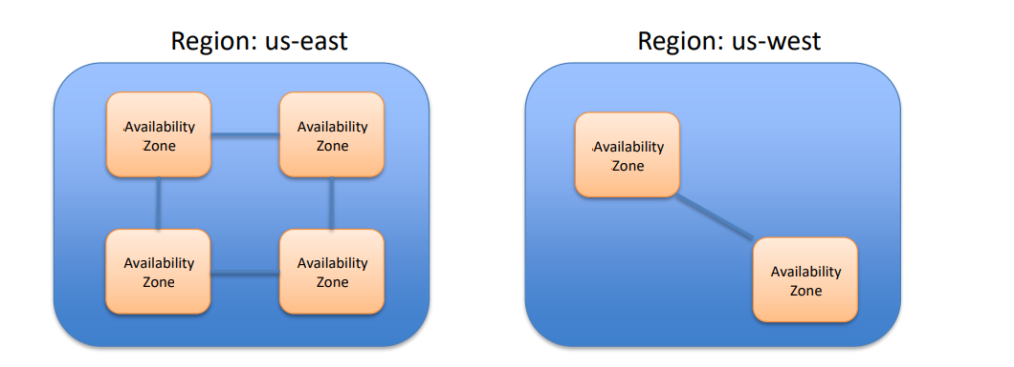
AWS Regions & Zones
AWS Infrastructure partitioned into many regions, each of which contains one or more availability zones (AZs).
Regions are in separate geographical locations around the world.
AZs represent distinct locations, comprised of one or more datacenters, within a particular region.
Availability zone IDs are an abstraction and will differ between customer accounts.
www.corvit.com

Slide 13
Identity & Access Management (IAM)
IAM allows organizations to create users and manage their access to AWS resources.
Provides granular governance controls and federated access. – Password expiration/strength – Login via Active Directory, Facebook, etc. – Restrict access to specific services and resources.
Signup account (root account) is your master account, best practice is to not use it for day-to-day management.
www.corvit.com

Slide 14
IAM Terms
User: an individual setup with an account in IAM.
Group: a set of users sharing similar access privileges.
Role: access privileges that may be assigned to AWS resources. – Lets resources act like users with specific privileges.
Policy: a document containing one or more defined privileges.
www.corvit.com

Slide 15
IAM
IAM is global, any changes we make impact all regions.
All activities we do on the web console may also be done via command line or SDK.
IAM users sign-in link is the web login URL for users (and it may be customized).
IAM Security Status shows important security steps (recommend turning on MFA).
www.corvit.com

Slide 16
IAM
Create new user – Each user has a user name, password, access key ID, and secret access key. – User name and password required to log into web console. – Access key and secret access key required to use AWS API (** KEEP THESE SAFE!!)
Create a new group – Each group has one or more policies attached. – Policies define access privileges for group members.
Account Settings – Define password strength/expiration requirements.
Roles – Allow a resource to access other resources with set privileges. – Example: Allow webserver on EC2 to retrieve files stored on S3.
www.corvit.com

Slide 17
AWS EC2 Instance
EC2 stands for Elastic Compute Cloud
Amazon EC2 provides scalable computing capacity in the AWS Cloud
You can use Amazon EC2 to launch as many or as few Virtual Servers as you need, Configure Security and Networking and manage Storage.
Amazon EC2 enables you to Scale Up or Scale Down the instance.
Amazon EC2 is having two storage options for Root Volume i.e. EBS(Elastic Block Store) & Instance store.
Preconfigured templates are available known as Amazon Machine Image.
By default, you can create 20 EC2 instances in a particular region with high I/O instances.
www.corvit.com

Slide 18
Types of EC2 Instances
General Purpose: Balanced Memory & CPU
Compute Optimized: More CPU than RAM
Memory Optimized: More RAM
Accelerated Computing/GPU: Graphics Optimized
Storage optimized: Low Latency
High Memory Optimized: High Ram, Nitro System (Special Hypervisor)
Previous Generation
www.corvit.com

Slide 19
General Purpose Instances
Provides a Balance of Compute, Memory and Networking Resources, and can be used for a variety of Workloads.
Instances are available in four sizes.
Nano, Small, Medium and Large.
A series (A1) : Supports Medium and Large Tiers.
M Series (M4, M5, M5a, M5ad, M5d) : Supports Large Tier.
T Series (T2, T3, T3a): Small and Free Tier.
We would be working with T2 (Micro or Nano) instance which is available on Free Tier.
www.corvit.com

Slide 20
General Purpose Instances (A Series)
A1 instances are ideally suited for Scale-out workloads.
These instances can be used for hosting Web Servers, Containerized Micro Services. Caching Servers and Distributed Data Stores.
www.corvit.com

Slide 21
General Purpose Instances (M Series)
M4 Instance
vCPU: 2 to 40 (Max)
RAM: 8GB to 160 GB (Max)
Instance Storage: EBS Only
M5a, M5ad and M5d Instances
vCPU: 2 to 96 (Max)
RAM: 8 to 384 (Max)
Instance Storage: EBS & NVMe SSD
Can used to Host Game Servers, Web Servers, Small and Medium Databases.
www.corvit.com

Slide 22
General Purpose Instances (T Series)
Usually used for testing purposes.
Can be used to test Website and Web App, Code Repositories.
Development, Build ,Test.
Microservices
vCPU: 2 to 8
RAM: 0.5 to 32 GB
www.corvit.com

Slide 23
Compute Optimized Instances
Compute Optimized Instances are ideal for Compute-bound applications that benefit from high performance processors.
C Series is dedicated for these types of instances.
C4, C5 and C5n are available options.
Use to host Web Server, Batch Processing systems, Gaming and Video Encoding.
www.corvit.com

Slide 24
Compute Optimized Instances
C4
CPU: 2 to 36
RAM: 3.75 to 60 GB
Storage: EBS Only
Network: BW 10 Gbps
C5
Powered by AWS Nitro System
Support max 25 EBS volumes (1 would be root and other 24 can be other.)
Uses Elastic Network Adapter
vCPU: 2 to 72
RAM: 4 to 192 GB
Network: BW up to 25 Gbps
Storage: EBS & NVMe SSD
www.corvit.com

Slide 25
Memory Optimized Instances (R Series)
Memory Optimized instances are designed to deliver fast performance for Workloads that process large data set in Memory.
R Series, X Series and Z Series are dedicated for these.
R4, R5, R5a, R5ad and R5d
High Performance, Relational (MySQL) and No SQL (MongoDB, Cassandra) databases.
Distributed Web Scale Cache stores that data provide in-memory caching of key value type data.
Used in Financial Services, Hadoop.
vCPU: 2 to 96
RAM: 16 to 768 GB
Storage: EBS & NVMe SSD
www.corvit.com

Slide 26
Memory Optimized Instances (X Series)
X1 and X1e Instances
Well suited for High Performance database, Memory intensive enterprise application, Relational database workload, SAP HANA
Electronic Design Automation
vCPU: 4 to 128
RAM: 122 to 3904 GB
Storage: SSD
www.corvit.com

Slide 27
Memory Optimized Instances (Z Series)
Z1d Instance
Delivers a sustained all Core Frequency of up to 4.0 Ghz, the fastest of any Cloud instances.
AWS Nitro System, Xeon Processor, up to 1.8 TB of instance storage.
Used for Electronic Design Automation and certain databases workloads with high pre-core licensing cost.
vCPU: 2 to 48
RAM: 16 to 384 GB
Storage: NVM SSD
www.corvit.com

Slide 28
Storage Optimized Instances
Storage Optimized Instances are designed for workloads that require high, sequential read and write access to very large data sets on local storage.
They are optimized to deliver tens of thousands of Law Latency, Random I/O operations per second (IOPs) to application.
I series, H Series and D Series are available for these.
www.corvit.com

Slide 29
Storage Optimized Instances (D Series)
D2 Instances
Well suited for Massive Parallel Processing (MPP) data Warehouse, Map reduce and Hadoop distributed computing, Log or data Processing app.
vCPU to 36
RAM: 30.5 to 244GB
Storage: SSD
www.corvit.com
Notes:
Apache Hadoop is a collection of open-source software utilities that facilitates using a network of many computers to solve problems involving massive amounts of data and computation. It provides a software framework for distributed storage and processing of big data using the MapReduce programming model.

Slide 30
Storage Optimized Instances (H Series)
H1 Instances
This family features up to 16 TB of HDD Based local storage, high disk throughput and balance of Compute & Memory.
Well suited for App requiring Sequential access to large amounts of data on direct- attached instance storage.
Application that requires high throughput access to large quantities of data.
vCPU: 8 to 64
RAM: 32 to 256GB
Storage: HDD
www.corvit.com

Slide 31
Storage Optimized Instances (I Series)
I3 and I3en Instances
Well suited for High frequency online transaction processing system (OLTP), Relational Databases, No SQL Databases, Distributed file system and Data Warehousing application.
vCPU: 2 to 96
RAM: 16 to 768 GB
Storage: NVMe SSD
Network Performance: 25 Gbps to 100 Gbps
Sequential Throughput :
Read: 16 GB/s
Write: 6.4 Gb/s (I3)
8 Gb/s (I3en)
www.corvit.com

Slide 32
Accelerated Computing Instances
Accelerated Computing Instance families use hardware accelerate, or co-processors to perform some functions such as floating point number calculation, graphics processing or data pattern matching more efficiently than is possible in software running on CPUs.
P series, G series and F series are available for these.
www.corvit.com

Slide 33
Accelerated Computing Instances (F Series)
F1 Instance
F1 Instances offers Customizable Hardware acceleration with Field Programmable Gate arrays (FPGA).
Each FPGA contains . Million logic elements & 6800 DSP (Digital Signal Processing) engines.
Designed to accelerate computationally intensive algorithms such as data flow or highly parallel operations.
Used in Genomics Research, Financial analytics, Real time video processing and Big data search.
vCPU: 8 to 64
FPGA: 1 to 8
RAM: 122 to 976 GB
Storage: NVMe SSD
www.corvit.com
Notes:
FPGA are used in DSLR Camera.

Slide 34
Accelerated Computing Instances (P Series)
P2 and P3 Instances
It uses NVIDIA Tesla GPUs
Provide high Bandwidth Networking.
Up to 32 GB of Memory per GPU, which makes them ideal for deep learning.
Used in Machine Learning, Seismic Analysis.
www.corvit.com
Notes:
Seismic Analysis is the study of earthquakes.

Slide 35
Accelerated Computing Instances (P Series)
P2 Instance
P3 Instance
vCPU: 4 to 64
GPU: 1 to 16
RAM: 61 to 732 GB
GPU RAM: 12 to 192 GB
Network BW: 25 Gbps
vCPU: 8 to 96
GPU: 1 to 8
RAM: 61 to 768 GB
Storage: SSD and EBS
www.corvit.com

Slide 36
Accelerated Computing Instances (G Series)
G2 and G3 instances
Optimized for graphics Intensive application.
Well suited for app like 3d visualization, Video creation services, Streaming Graphics-intensive application.
G3 instances use NVIDIA Tesla M60 GPU and provide a cost effective, high performance platform for Graphics applications.
vCPU: 4 to 64
GPU: 1 to 4
RAM: 30.5 to 488 GB
GPU Memory: 8 to 32 GB
Network Performance: 25 Gbps.
www.corvit.com

Slide 37
High Memory Instances
U series is dedicated for these
High Memory Instances are purchase built to run large in memory databases including production developments of Sap in the cloud.
Latest generation Intel Xeon Pentium 8176M Processor.
6, 9, 12 TB of instance Memory, the largest of any Ec2 instance.
These instances are bare metal instances and do not run on a Hypervisor.
Only available under Dedicated purchasing Category (For 3 years Term)
OS directly installed on hardware
Powered by the AWS Nitro System, a combination of dedicated hardware and lightweight hypervisor.
Bare Metal Performance with direct access to host hardware.
EBS optimized by default at no additional cost.
Models: U-6tbl.metal , U-9tbl.metal , U-12tbl.metal
Network Performance: 25Gbps
Dedicated EBS BW: 14 Gbps
Each instance offer 448 logical processor.
www.corvit.com

Slide 38
Previous Generation Instances
T1, M1, C1, CC2, M2, CR1, Cg1, i2, Hs1, M3, C3 and R3
www.corvit.com

Slide 39
EC2 Instance Purchasing Model
There are 6 purchasing options to pay for EC2 instance. On demand, Dedicate Instance, Dedicated Host, Spot Instance, Schedule Instance and Reserved Instance (Standard RI, Convertible RI, Schedule RI)
But mainly we can pay for three types : on demand (Dedicated Instance and Host are costed according to on demand), Reserved (Scheduling instance is costed according to reserved instance) and spot instances.
You can pay for Dedicated Host which provide you with EC2 instance on standard servers dedicated for your use.
www.corvit.com

Slide 40
EC2 Instance Purchasing Model (On Demand)
Aws on demand instances are virtual servers that run in AWS or AWS Relational Database Service RDS and are purchased at a fixed Rate per Hour.
Aws recommends using On-demand instances for applications with short term irregular workloads that cannot be interrupted.
They are also suitable for use during testing and development of applications on EC2.
With on demand instances you only pay for EC2 instances you use.
The use of on demand instances frees you from the Cost and complexities of planning, purchasing and maintaining hardware and transforms what are commonly large fixed costs into much smaller variable cost.
Pricing is per instance-hour consumed for each instance, from the time on instance is launched until it is terminated or stopped.
Each partial instance hour consumed will be billed per second for Linux instances and as a full hour for all other instances types.
www.corvit.com

Slide 41
EC2 Instance Purchasing Model (Dedicated Instance & Host)
Dedicated Instance
Dedicated Host
These instances run in a VPC on hardware that is dedicated to a single customer
Your dedicated instances are physically isolated at the host hardware level from instances that belong to other AWS Account.
Pay for dedicated instances on demand. Save up to 70% by purchasing Reserved instances or save up to 90 % by purchasing Spot Instances.
An AWS EC2 Dedicated Host is a Physical server with EC2 Instance capacity fully dedicated to your use.
Dedicated Host can help you address compliance requirement and reduce costs by allowing you to use your existing server bound software licenses.
Pay for a physical host that is fully dedicated to running your instances, and bring your existing per socket per core or per VM software license to reduce cost.
www.corvit.com

Slide 42
EC2 Instance Purchasing Model (Spot Instances)
AWS EC2 Spot instances let you take advantage of unused EC2 capacity in the AWS cloud. Spot instances are available at up to 90% discount compared to on demand prices.
You can use Spot instances for various test and development workloads.
You also have the options to hibernate, stop or terminate your spot instances when EC2 reclaims the capacity back with two minutes of notice.
Data would be cleared once you stop but not the is the case while hibernating.
For two primary reasons your spot instance get interrupted:
- AWS EC2 capacity requirement (e.g. on demand or reserved.) - If you have choose to set a max spot price and the spot price rises above this.
www.corvit.com

Slide 43
EC2 Instance Purchasing Model (Schedule Instances)
Schedule Reserve Instances enable you to purchase capacity reservations that recur on a daily, weekly or monthly basis with a specified start time and duration for one year term.
You reserve the capacity in advance so that you know it is available when you need it.
You pay for the time that the instances are scheduled even if you do not use them.
Schedule instances are a good choice for workloads that do not continuously but do run on a regular schedule.
Purchase instances that are always available on the specified recurring schedule for one year term.
For example you can use schedule instances for an application that runs during business hours or batch processing that run at the end of the week.
www.corvit.com

Slide 44
Reserved Instances
AWS EC2 RI provide a significant discount (up to 75%) compared to on demand pricing and provide a capacity reservation when used in a specific availability zone.
Reserved instances give you the option to reserve a DB instance for a one or three year term and in turn receive a significant discount compared to the on demand instance pricing for the DB instance.
www.corvit.com

Slide 45
Types of Reserved Instances
There are three types of EC2 instances
Standard RI: These provide the most significant discount (up to 75%) off on demand and are best suited for steady state usage.
Convertible RI: These provide a discount (up to 54%) and the capability to change the attributes of the RI as long as the exchange results in the creation of reserved instances of greater or equal.
Schedule RI: These are available to launch within the time window you reserve.
www.corvit.com

